Slide 2
TUM Workshop 2016 - Kickoff

Slide 3
ESR Labs is a software company
with the focus on
embedded and automotive systems
4 years old
Almost 100 employees
￼

Slide 4

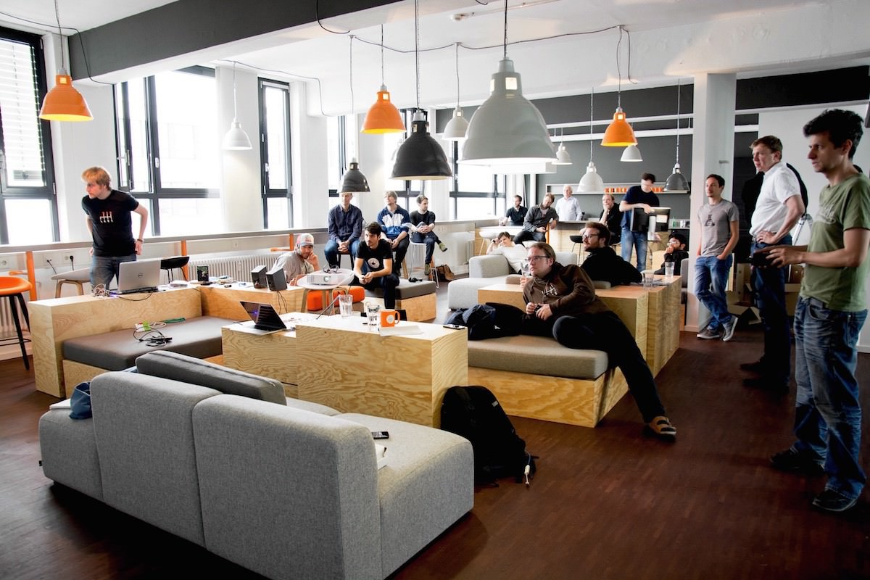
ESR Labs - Culture and inspiration
ESR Labs is a company build by programmers

Slide 5
TUM Workshop: The Project
Enhance our current carsharing system
Work in teams of 4 and create a distributed solution
Technologies:
PowerPC C++ Code: responsible for Bus communications
Android App with Head Unit connection
Goal:
Receive location data from the CAN bus
Process data on android Platform
Display Popups on the Head Unit

Slide 6
TUM Workshop: Timeframe
3 Appointments for the Workshop
Monday, 4. 7.: 10 - 12, 12 - 14 and 14 - 16
Tuesday, 5. 7.: 10 - 12 and 12 - 14
Thursday, 7.7.: 10 - 12 and 12 – 14
Closing event (est. between 11.7 – 15.7)
Test drive of all working solutions
Awards for the best group

Slide 7
TUM Workshop: Further Information
All code and Infos are available on Github:
https://github.com/esrlabs/TUM
Contact:
Alexander Schlenk (alexander.schlenk@esrlabs.com)

